Slide 1
Discussion on Population Growth Models for Sustainable Development
Name : Rupak Sarkar Roll No.: 14271024036 Stream : MCA Semester : Semester 1st Subject : Environment and Ecology Subject Code : MCAN-E105A

Slide 2
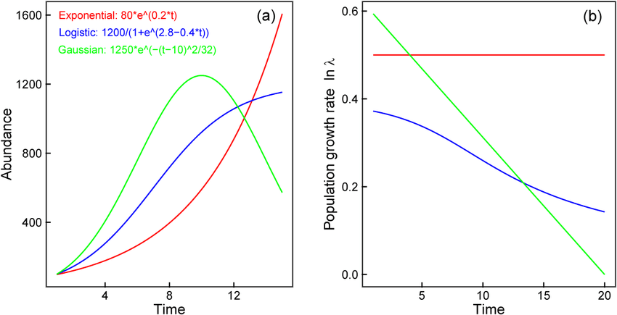
What are Population Growth Models?
Population growth models are mathematical and theoretical frameworks used to describe how populations change over time. They are crucial in understanding the dynamics of human populations and their impact on resources, ecosystems, and socio-economic systems.

Slide 3
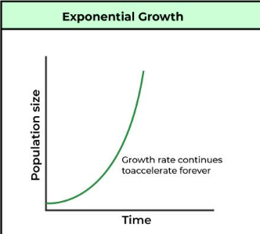
1. Exponential Growth Model
The Exponential Growth Model describes a process where the rate of growth of a quantity is directly proportional to its current size. This model is widely used in various fields such as biology, economics, and population studies to explain situations where growth accelerates over time.
Mathematical Formula –
The general form of the exponential growth model is:
N(t)=N₀​e^{rt}
N(t): The quantity at time t.
N₀: The initial quantity(at t=0)
r: The growth rate (expressed as a decimal)
t: Time
e: The base of natural logarithms (≈2.718)

Slide 4
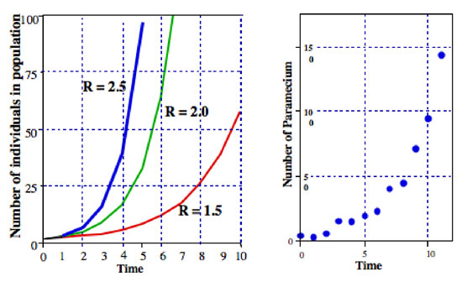
Characteristics of Exponential Growth
Constant Relative Growth Rate: The rate of growth is proportional to the current value, leading to faster growth as time progresses.
J-Shaped Curve: When plotted, exponential growth results in a steeply rising curve.
Doubling Time: The time it takes for the quantity to double can be calculated using:
T= ln(2)
__________
r

Slide 5
Examples of Exponential Growth
Population Growth:
If a population starts with 1,000 individuals and grows at a rate of 5% per year (r=0.05r = 0.05r=0.05):
N(t)=1000e^{0.05t}
2. Over 10 years (t=10), the population would grow to:
N(10)=1000e^{0.5}≈1649
2. Bacterial Growth:
A bacteria culture doubles every 2 hours. Starting with 100 bacteria:
Doubling time T = 2, so r = ln(2)/2 ≈ 0.346, N(t) = 100e^{0.346t}

Slide 6
Applications of Exponential Growth
Ecology: Modeling population growth in ideal conditions.
Finance: Calculating continuously compounded interest.
Physics: Radioactive decay (negative growth rate).
Epidemiology: Tracking the spread of infectious diseases.
Limitations of the Model
Unsustainable in Reality: Exponential growth assumes unlimited resources, which is unrealistic in most real-world scenarios.
Logistic Growth as a Refinement: In ecosystems, exponential growth transitions to logistic growth when resources become limited, resulting in a sigmoid (S-shaped) curve.
Understanding exponential growth helps analyze rapid changes and predict future trends under ideal conditions.

Slide 7
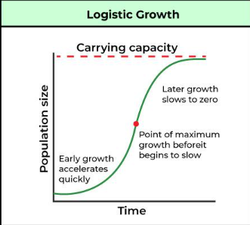
1. Logistic Growth Model
The Logistic Growth Model describes a process where growth initially resembles exponential growth but slows as the population reaches a carrying capacity due to resource limitations. It is widely used in biology, ecology, and social sciences to model population growth and other processes constrained by environmental factors.
Mathematical Formula
The logistic growth model is expressed as:
N(t) = K / 1 + (K – N₀ / N₀) e^{-rt}
N(t): The population (or quantity) at time t.
N_{0​}: The initial population at t = 0
K: The carrying capacity(maximum sustainable population)
r: The intrinsic growth rate (per unit time)
t: Time
e: The base of natural logarithms (≈2.718)

Slide 8
Characteristics of Logistic Growth
S-Shaped Curve (Sigmoid Curve): Growth starts exponentially, then slows, and finally plateaus as the population approaches the carrying capacity.
Carrying Capacity: Represents the maximum population that the environment can sustain indefinitely.
Growth Rate Decline: As N(t)N(t)N(t) approaches KKK, the growth rate dN/dt​ decreases.
The rate of change is given by: dN/dt = rN(1 - N/K)
This shows that growth is fastest when N is half of K.

Slide 9
Applications of the Logistic Growth Model
Ecology: Modeling species populations with limited resources.
Epidemiology: Predicting the spread of diseases under intervention scenarios.
Economics: Modeling market dynamics, including product adoption rates.
Sociology: Modeling growth in social phenomena, like language spread or cultural practices.
Limitations of the Logistic Growth Model
Simplified Assumptions: Assumes constant carrying capacity and growth rate, which may not hold in dynamic environments.
Oversimplification of Interactions: Ignores factors like predation, competition, or sudden environmental changes.
Delay in Response: In some populations, the response to environmental changes is delayed, leading to oscillations or overshoots.

Slide 10
Examples of Logistic Growth
Disease Spread:
The spread of a virus can be modeled logistically when herd immunity or medical interventions limit the number of infections.
Initial Infections (N0) = 10
Total susceptible population (K) = 1,000,000
Infection Rate (r) = 0.01
Market Penetration:
Adoption of a new technology often starts rapidly but slows as the market saturates.
Conclusion
The logistic growth model provides a realistic framework for understanding population dynamics and constrained growth processes. Its applicability across diverse disciplines underscores its value in predicting and managing systems affected by resource limitations

Slide 11
Thank You!

